Slide 1

Regulating Genome Editing in Australia
Dianne Nicol
Centre for Law and Genetics
University of Tasmania

Slide 2
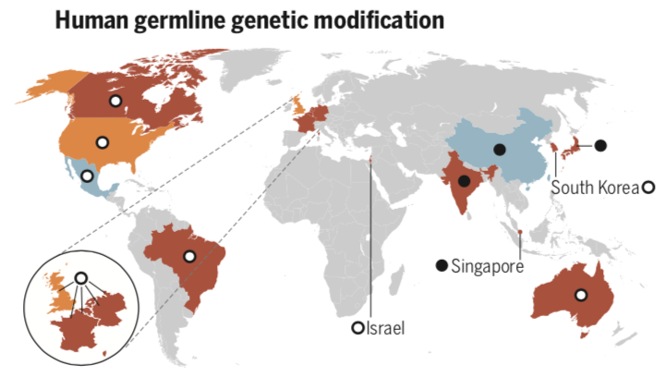
Germline genome editing and embryo research – mixed regulatory approaches globally
From R. Isasi, E. Kleiderman, B. M. Knoppers. 2016. Editing policy to fit the genome. Framing genome editing policy requires setting thresholds of acceptability. Science 351: 337-339

Slide 3
Prohibition of Human Cloning for Reproduction Act 2002
S 12 PHCR Act | Creates an offence for creating a human embryo for a purpose other than achieving pregnancy in a woman | 15 years imprisonment
S 13 PHCR Act | Creates an offence for creating a human embryo by fertilisation that contains genetic material provided by more than 2 persons | 15 years imprisonment
S 15 PHCR Act | Creates an offence for making heritable changes to the genome | 15 years imprisonment
S 17 PHCR Act | Creates an offence for creating a chimeric embryo | 15 years imprisonment
S 20 PHCR Act | Creates an offence for importing, exporting or placing a prohibited embryo in the body of a woman | 15 years imprisonment

Slide 4
Research Involving Human Embryos Act 2002
S 10 RIHE Act | Creates an offence for use of an excess ART embryo, unless under licence or exempt (eg unsuitable for implantation) | 5 years imprisonment
S 10A RIHE Act | Creates an offence for use of a human embryo created by other processes, Uunless under licence | 5 years imprisonment
S 10B RIHE Act | Creates an offence for research and training involving fertilisation of a human egg by a human sperm up to the first mitotic division, unless under licence | 5 years imprisonment
S 11 RIHE Act | Creates an offence for using an embryo that is not an excess ART embryo | 5 years imprisonment

Slide 5
Reform?
First legislative review in 2005:
Amendment to allow limited SCNT
Second review in 2011:
Further amendments not implemented
Australian Senate Community Affairs Committee 2018, Science of mitochondrial donation and related matters, recommendations:
Consultation paper on options for reform
Community consultation
Advice on whether mitochondrial donation is distinct from germline genome editing

Slide 6
Somatic cell genome editing
US National Academies, Human Genome Editing: Science, Ethics, and Governance
Existing regulatory infrastructure and processes for reviewing and evaluating somatic gene therapy to treat or prevent disease and disability should be used to evaluate somatic gene therapy that uses genome editing.
Nicol et al (2017). Key challenges in bringing CRISPR- mediated somatic cell therapy into the clinic. Genome Medicine 9:85
Genome editing using CRISPR and CRISPR-associated proteins offers the potential to facilitate safe and effective treatment of genetic diseases refractory to other types of intervention. Here, we identify some of the major challenges for clinicians, regulators, and human research ethics committees in the clinical translation of CRISPR- mediated somatic cell therapy.

Slide 7
Multiple layers of regulatory uncertainty in Australia
Patent landscape
Product marketing approval
Consent
Gene technology regime
Professional codes, peer review
Health Technology Assessment
Research/clinical ethics

Slide 8
Conclusion
Australia’s regulatory approach to germline genome editing is prohibitory
Genome editing embryo research appears difficult to licence
There are a number of regulatory uncertainties for somatic cell genome editing
Reform (should it happen) will take time

